Slide 1




UX AUDIT REPORT
JULY 2023
High level expert review
Heuristic evaluation & user interviews

Slide 2
1. INTRODUCTION - What we did
Executive Summary
Goals and objectives
2. METHODOLOGY- Process and Methods
Nielsen's Heuristic Evaluation
Ben Shneiderman’s 'Eight Golden Rules of Interface Design
Arnold Lund's 34 Usability Maxims
Norman's Theory of Action
Web3 Design Audit Checklist Based on Web3 Design Principles by Beltran
3. FINDINGS - What we tested on
Recommendations
4. INSIGHTS AND NEXT STEPS - What we tested on
Recommendations
In this report

Slide 3

CURVE FINANCE UX AUDIT REPORT
INTRODUCTION

Slide 4
CURVE FINANCE
UX AUDIT REPORT

Slide 5
EXECUTIVE SUMMARY
In this comprehensive UX audit, we conducted an expert review of Curve Finance user experience based on Web3 usability guidelines and expert review checkpoints. The aim was to assess the platform's alignment with industry best practices, ensuring a seamless and user-centric experience for all users interacting with Web3 technologies.
Our review focused on evaluating critical aspects such as platform accessibility, navigation, search functionality, user education, error handling, and the integration of Web3 wallet functionalities. Through a meticulous assessment, we identified several areas that require immediate attention to enhance the overall user experience.

Slide 6
247 WEB USABILITY GUIDELINES
This review focused on evaluating critical aspects such as platform accessibility, navigation, search functionality, user education, error handling, etc. Through a meticulous assessment, we identified several areas that require immediate attention to enhance the overall user experience.
UX PRINCIPLES | COMPLIES | DOESN’T COMPLY | NOT APPLICABLE | COMPLIANCE RATE
Task orientation | 20 Criteria | 11 Criteria | 1 Criteria | 66%
Navigation and IA | 12 Criteria | 12 Criteria | None | 50%
Forms and data entry: | 11 Criteria | 5 Criteria | 2 Criteria | 69%
Trust and credibility | 10 Criteria | None | None | 100%

Slide 7
UX PRINCIPLES | COMPLIES | DOESN’T COMPLY | NOT APPLICABLE | COMPLIANCE RATE
Writing and content quality | 16 Criteria | 1 Criteria | 1 Criteria | 94%
Page layout and visual design: | 33 Criteria | 3 Criteria | 2 Criteria | 91%
Search usability | 6 Criteria | 10 Criteria | 4 Criteria | 37%
Help, feedback and error tolerance | 16 Criteria | 11 Criteria | 3 Criteria | 59%
Total | 124 Criteria | 53 Criteria | None | 70%

Slide 8
REVIEW BASED ON WEB3 UX PRINCIPLES
By Beltran
This review focused on evaluating critical aspects involved in the integration of Web3 wallet functionalities.
UX PRINCIPLES | COMPLIES | DOESN’T COMPLY | NOT APPLICABLE | COMPLIANCE RATE
Transparency of Data provenance | 1 Criteria | 3 Criteria | None | 25%
Transparency of Transactions | 5 Criteria | 3 Criteria | None | 62%
Transparency of Smart Contract | 1 Criteria | 2 Criteria | None | 33%
Transparent User interaction History | None | 3 Criteria | None | 0%
Transparency of Code | 2 Criteria | 5 Criteria | None | 29%

Slide 9
UX PRINCIPLES | COMPLIES | DOESN’T COMPLY | NOT APPLICABLE | COMPLIANCE RATE
Human Readable Hashes Format | 2 Criteria | 2 Criteria | None | 50%
Time/Wait Management | 1 Criteria | 1 Criteria | None | 50%
Permanent Newbie Mode | None | 3 Criteria | None | 0%
Gas Price and Transaction Reversal | 1 Criteria | 2 Criteria | None | 33%
Sense of Community | 4 Criteria | 0 Criteria | None | 100%
Total | 17 Criteria | 24 Criteria | None | 40%

Slide 10
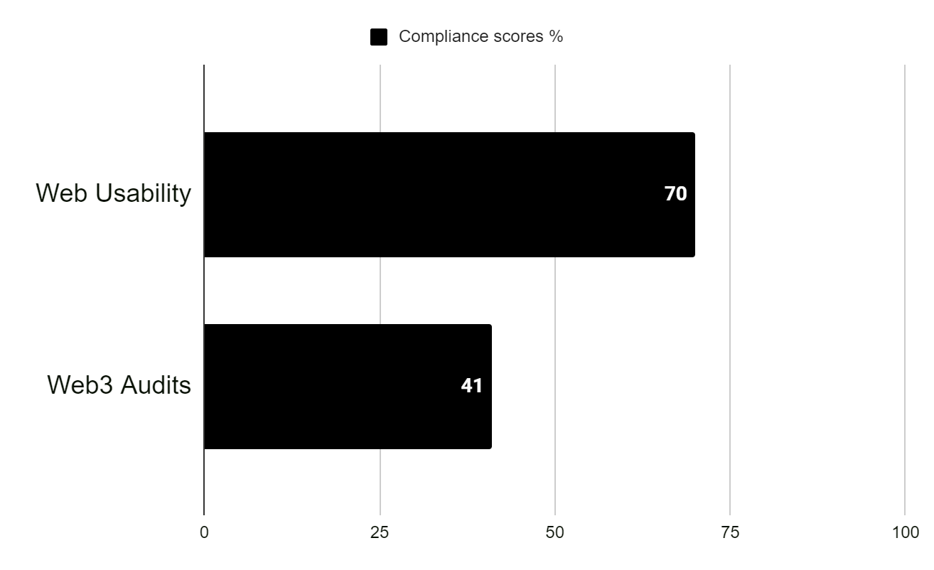
USABILITY STATS
Overall Compliance percentage
Usability Score
MODERATE
64.5%
Users should be able to use this site or system and complete most important tasks, however the user experience could be significantly improved.
Overall Compliance
Overall non compliance
141/218
77/218

Slide 11
PRODUCT OVERVIEW
Curve Finance is a decentralized finance (DeFi) protocol built on the Ethereum blockchain. It focuses on providing efficient and low-slippage trading for stablecoins and other similar assets.
The primary goal of Curve Finance is to enable users to swap between different stablecoins at minimal cost and with minimal slippage.
CONTEXT OF THE AUDIT
This study involved collecting a rich research database consisting of detailed observations and findings which includes Observations of the most insightful users gotten during during the research process. These valuable resources complement and support the findings presented in this report.

Slide 12
CURVE FINANCE UX AUDIT REPORT
METHODOLOGY

Slide 13
METHODOLOGY
This report summarizes the findings of a comprehensive UX audit conducted on Curve Finance platform.
The audit utilized a combination of renowned UX methodologies, including Nielsen's Heuristic Evaluation, Ben Shneiderman’s 'Eight Golden Rules of Interface Design, Arnold Lund's 34 Usability Maxims, Norman's Theory of Action, and the Web3 Design Audit Checklist Based on Web3 Design Principles by Beltran.
The purpose of the audit was to assess the user experience and identify areas for improvement to enhance usability and overall satisfaction

Slide 14
SEVERITY SCALE
Critical
Severely impairs the use of the product and cannot be overcome by users. It is necessary to fix this before releasing the product..
Serious
Occurs frequently and persistently, or users may not be able to resolve the issue or may not be aware of it. It's important to fix this, so give it a high priority..
Medium
May occur more often or be harder to overcome. Fixing this should be a low release priority.
Low
Can be easily overcome by the user or occurs very rarely. The release does not require repair unless additional time is available.

Slide 15
CURVE FINANCE UX AUDIT REPORT
FINDINGS

Slide 16
BUSINESS GOALS
The business goal of Curve Finance is to provide a decentralized finance (DeFi) platform that specializes in efficient and low-slippage trading for stablecoins and similar assets. The primary objective is to create a platform that offers users a seamless and cost-effective way to swap between different stablecoins while minimizing price slippage. By focusing on stablecoin trading, Curve Finance aims to provide users with a reliable and efficient trading experience in the DeFi ecosystem.
Curve Finance also aims to incentivize liquidity provision through its liquidity pools, where users can deposit their stablecoins and earn trading fees. By attracting liquidity providers, Curve Finance aims to deepen the liquidity in its pools, enhance the stability of its trading pairs, and provide better trading opportunities for users.
In addition to trading, Curve Finance seeks to enable users to generate yields on their stablecoin holdings. By engaging in yield farming or other yield-generating strategies within Curve Finance, users can earn additional returns on their deposited assets.

Slide 17
CUSTOMER GOALS
Efficient Stablecoin Swapping: Users of Curve Finance aim to quickly and cost-effectively swap between different stablecoins with minimal slippage.
Seamless Liquidity Provision: Customers of Curve Finance, particularly liquidity providers, desire a platform where they can deposit their stablecoins into liquidity pools.
Yield Generation Opportunities: Curve Finance customers are interested in yield generation strategies and opportunities within the platform. They aim to earn additional returns on their stablecoin holdings by engaging in yield farming or other yield-generating activities facilitated by Curve Finance.
Trust and Security: Customers of Curve Finance prioritize the security of their assets and personal information. They seek a platform that implements robust security measures, undergoes regular audits, and provides a trustworthy and secure environment for their DeFi activities.
User-Friendly Experience: Curve Finance customers value a user-friendly platform that is easy to navigate, understand, and use. They appreciate intuitive interfaces, clear instructions, and helpful guidance to ensure a smooth and hassle-free experience when interacting with the platform.

Slide 18
FINDINGS
Heuristic Used
Select the appropriate heuristics principle that matches the usability issue you’ve identified.
Severity
From the severity scale, select the appropriate rating for the usability issue you’ve identified.
Issue and Recommendation
Describe the usability issue and spell out your recommendations for UX improvements.

Slide 19
CURVE FINANCE UX AUDIT REPORT
ONBOARDING AND FIRST IMPRESSION
The primary goal of the onboarding process is to help users understand and become proficient in using the product, thereby reducing any potential barriers to adoption and improving overall user satisfaction. It sets the stage for a positive user experience and lays the foundation for long-term engagement and retention.

Slide 20
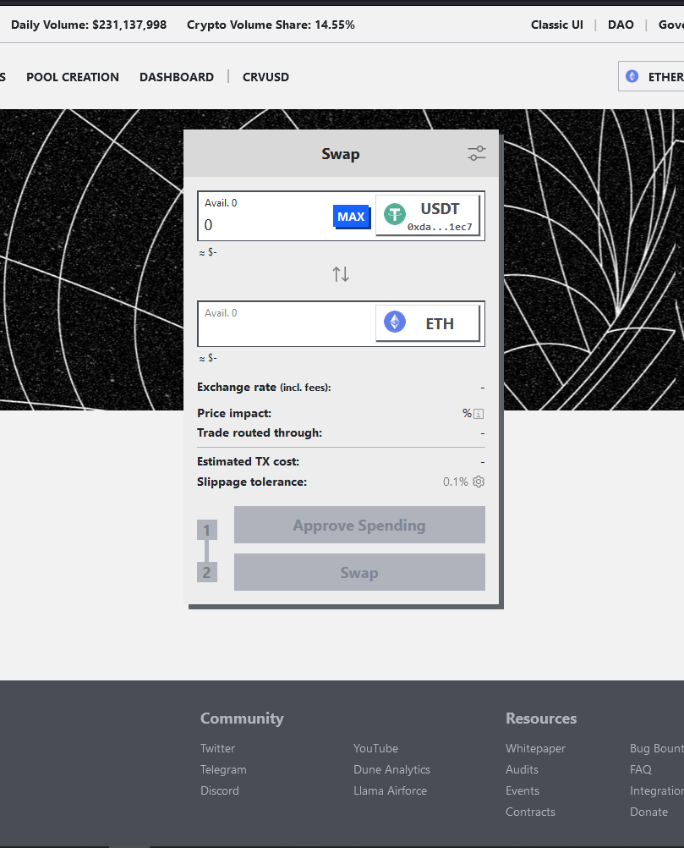
Heuristic Used
Recognition rather than recall
First Impression/ Lack of Educational Onboarding Process.
Issue (MEDIUM)
There is no onboarding experience for new users
Users are taking directly to the swap feature with no clear indication of what to expect
Recommendation
Create a homepage with introduction of the platform and its features

Slide 21
CURVE FINANCE UX AUDIT REPORT
NAVIGATION AND INFORMATION ARCHITECTURE
System or mechanism that allows users to move through different sections, pages, or features of a digital product. It includes menus, links, buttons, search bars, and other interactive elements that help users find and navigate to desired content or perform specific actions. Effective navigation design ensures that users can easily understand and access different areas of the product, enhancing usability and user satisfaction.
Information architecture (IA) involves the organization and structure of information within a digital product to facilitate efficient and intuitive access. It focuses on grouping and categorizing content in a logical and meaningful manner, ensuring that information is well-organized, easily discoverable, and understandable to users

Slide 22
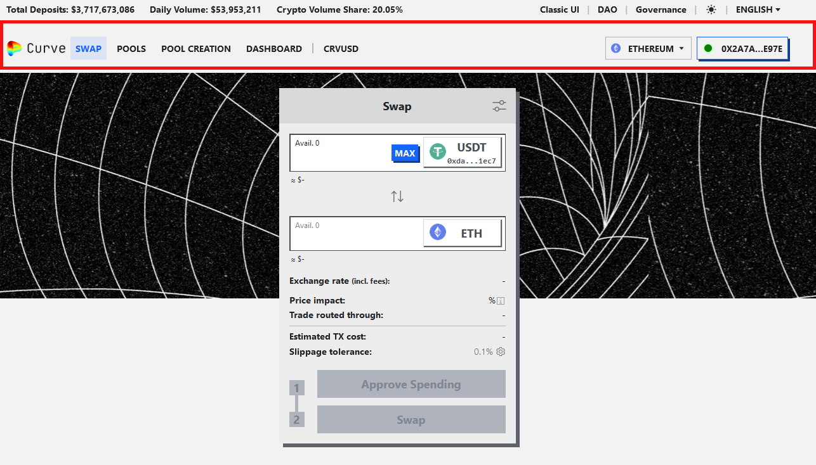
Heuristic Used
Consistency and standards
Navigation is not Entirely Clear.
Issue (MEDIUM)
When you first land on Curve Finance, the the UI will present you with the top navigation bar with multiple click areas that leads to numerous different menus and overlays. It is not easy to contextualize how these all fits in the overall flow.
Recommendation
Rethink the navigation and potentially regroup some elements under the same menu.

Slide 23
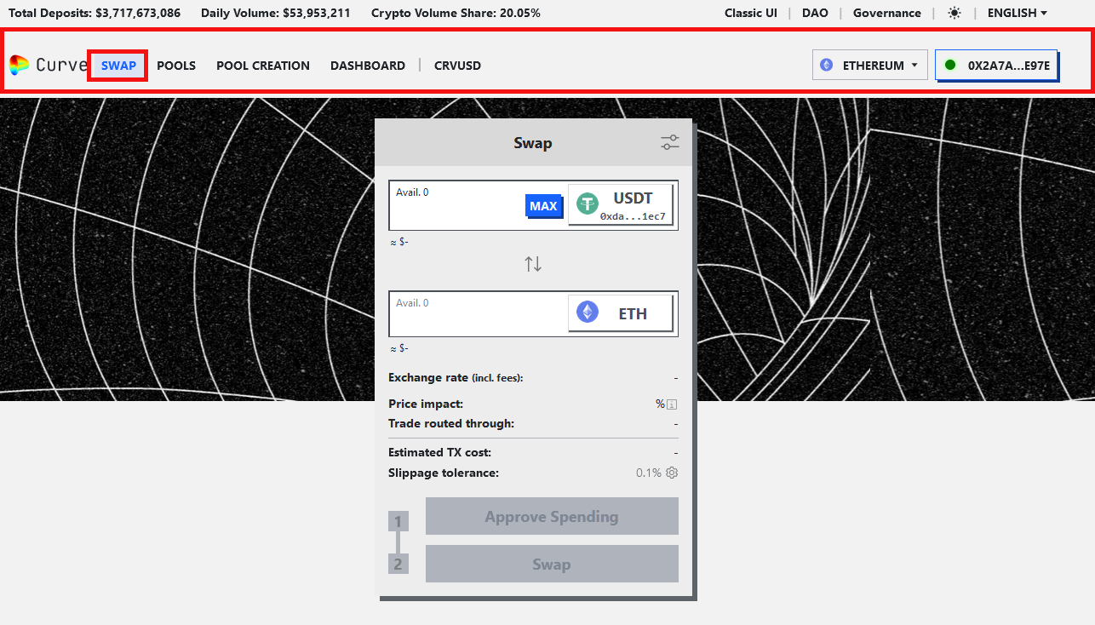
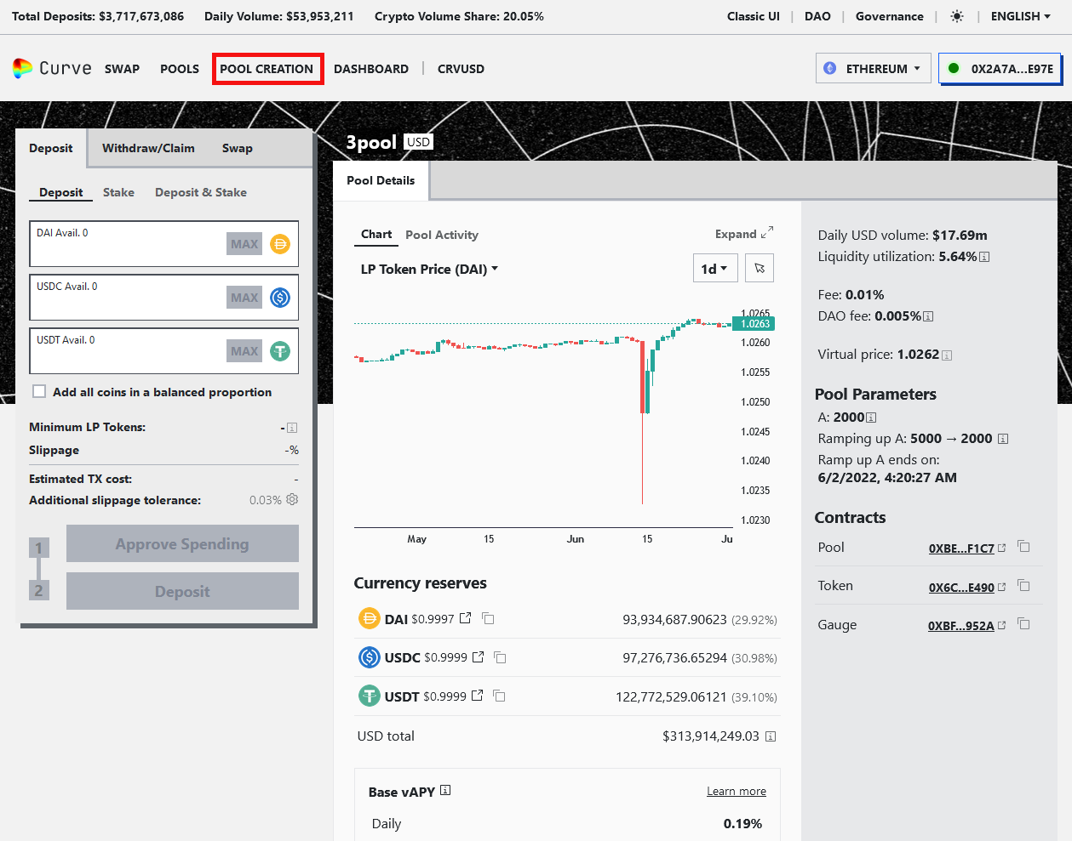
Heuristic Used
Flexibility and efficiency of use
Navigation is not Entirely Clear.
Issue (MEDIUM)
Curve Finance places the token swap and pool investment features at the same level of the information architecture. While the token swap feature is easily accessible, there is no straightforward method to swap tokens and deposit them into the pool.
Recommendation
To enhance the Curve user experience, Curve should can consider implementing the following measures :
Let the user flow lead from the first interaction point to the next .

Slide 24
CURVE FINANCE UX AUDIT REPORT
ERRORS, HELP AND LEARNABILITY
These guidelines help assess if the site helps prevent customers from making errors. A site is error-tolerant if, despite evident errors in input, the intended result may be achieved with either no or minimal corrective action by the customer.
For novices and experts alike there should be readily available ways for them to become comfortable with using your product. Easy access to FAQs, onboarding etc.

Slide 25
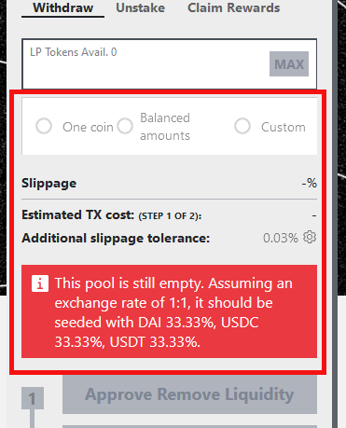
Heuristic Used
Help and documentation
Lack of contextual help.
Issue (LOW)
Curve caters primarily to experienced web3 users with its minimalist design. There is lack of instructions and proactive help to guide users in navigating its interface. It works with the assumption that all DeFi users know their way around Curve Finance. This Error modal is unnecessarily complicated for a first time user.
Recommendation
Include basic instructions on the interface, rather than relying solely on separate documentation that requires additional effort to locate.

Slide 26
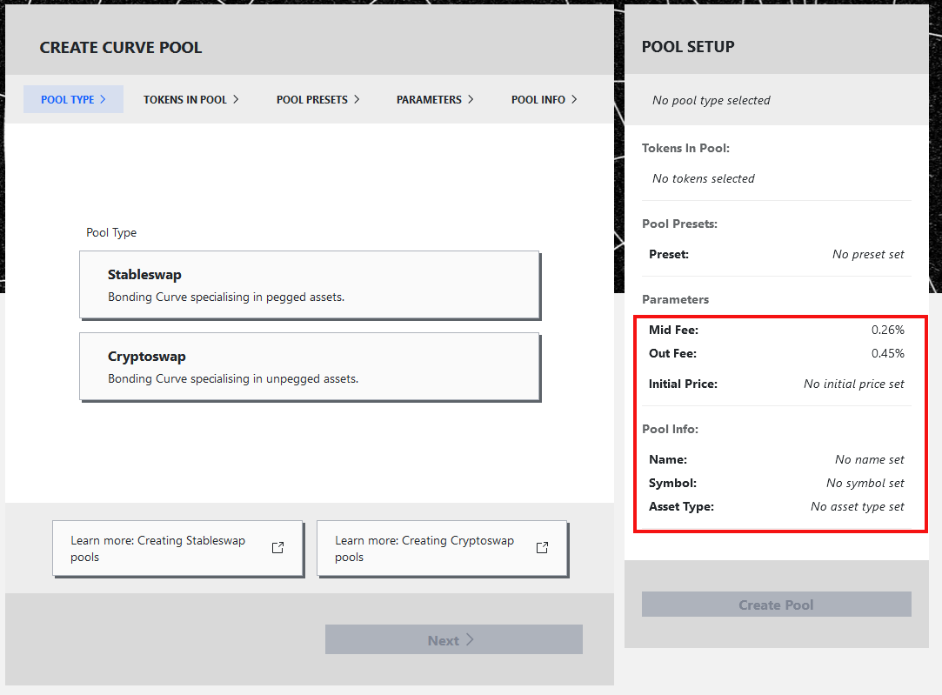
Heuristic Used
Help and documentation
Lack of contextual help.
Issue (MEDIUM)
Strange blockchain terminology and the complexity of blockchain platforms can be challenging for the first time users. In Curve Finance, there is a lack of instructions and contextual information to associated with a task. On top of that, much of the terms displayed has no explanation.
For example, there are some terms in DeFi space used in Curve Finance that doesn’t align with the established mental model of mainstream users:
What is a pool preset?
What is mid and out fee?
What are pegged tokens?

Slide 27
Recommendation
There should be some basic instructions in the app, not just on separate documentation requiring locating effort. Whenever necessary, provide timely, contextual information to assist to users.

Slide 28
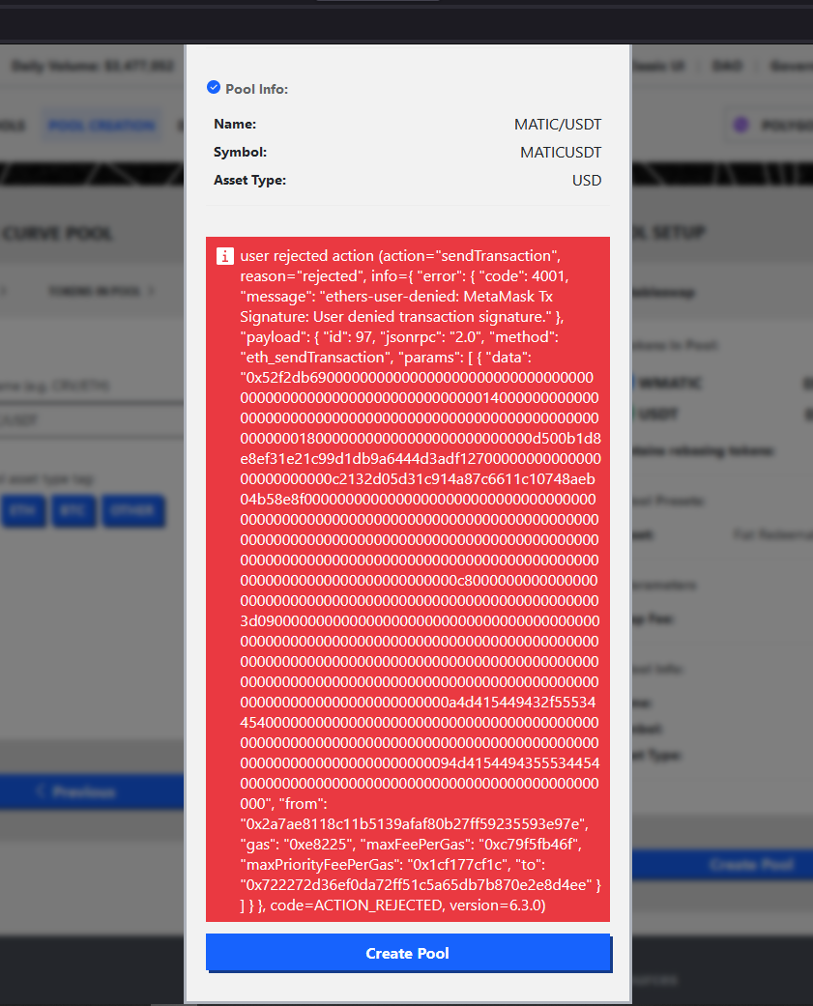
Heuristic Used
Error prevention
Description of the issue
Issue (LOW)
On Curve Finance, when users reject creating a new pool due to low gas fees, it shows an error message. The message reads like gibberish to the average user.
The error message displayed in this scenario is lengthy and not easy to understand.
Recommendation
Provide a clear error message that explicitly indicates that the transaction is rejected, and give advice that caters to novice users and users who wish to initiate a pool. In addition, give context to all transaction states.

Slide 29
CURVE FINANCE UX AUDIT REPORT
CONTENT AND DESIGN
The content and design in UX are interconnected and must work together harmoniously. Content should be presented in a visually pleasing manner, utilizing appropriate typography and formatting to enhance readability. Design choices should also consider the content's hierarchy, emphasizing important information and guiding users through the interface. Balancing visual aesthetics with clear and effective communication is essential for creating a positive user experience.

Slide 30
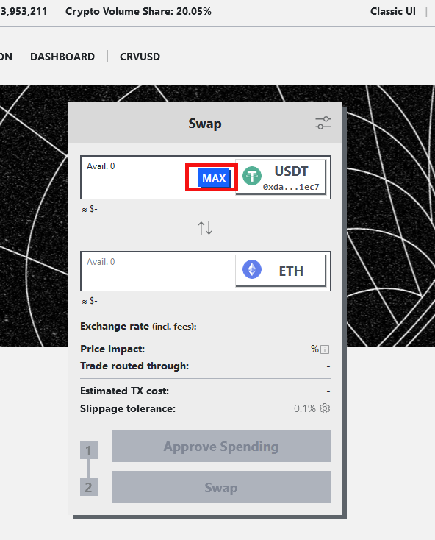
Heuristic Used
Aesthetic and minimalist design
Misleading feature to maximize the deposit amount
Issue (LOW)
The “Max” deposit button on the pool page can mislead users. While it allows for a quick and easy way to deposit the maximum amount of funds, users should be mindful to reserve some funds for gas fees.
Recommendation
Remind users to be cautious when using the “max” deposit button. Users should be aware that gas fees can fluctuate and vary based on price range and may not have enough funds for the transaction after maximizing the amount. Providing this information to users can help them avoid costly mistakes.

Slide 31
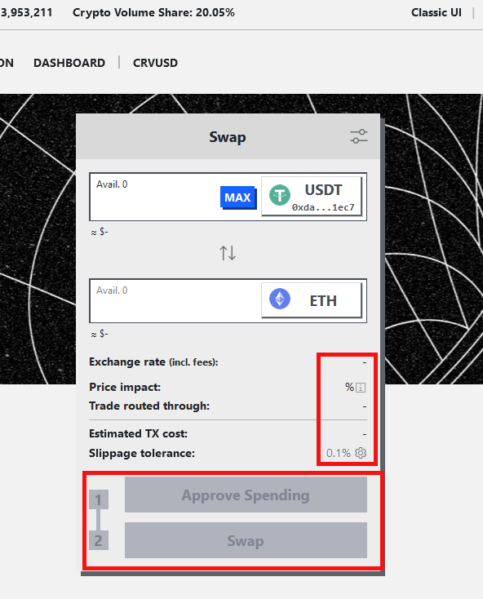
Heuristic Used
Aesthetic and minimalist design
Low Contrast
Issue (LOW)
Grey buttons with grey backgrounds give little contrast in the day mode
Recommendation
Increase contrast between elements on screen

Slide 32
CURVE FINANCE UX AUDIT REPORT
TRANSPARENCY OF DATA PROVENANCE
Does the application clearly indicate which data comes from the blockchain and which does not?
Are the addresses of the contracts clearly stated?
Are all blockchain data linked to independent blockchain explorers?
Is it clear which data comes from oracles?

Slide 33
Issue (LOW)
Recommendations
Curve does not clearly indicate which data originates from the blockchain and which data does not.
Furthermore, the addresses of the contracts are not clearly stated within the platform. This omission hampers the ability to verify the authenticity and integrity of the smart contracts involved, hindering transparency and exposing potential risks.
Moreover, the platform does not provide clear indications regarding the origin of data from oracles.
Improve Data Indication: Clearly differentiate between data originating from the blockchain and data from other sources.
Address Contract Address Visibility: Ensure that contract addresses are prominently displayed within the platform, allowing users and auditors to easily verify and authenticate the contracts.
Enhance Oracle Data Transparency: Clearly disclose the sources of data obtained from oracles, including information about the oracle providers, methodologies used, and data validation mechanisms.

Slide 34
CURVE FINANCE UX AUDIT REPORT
TRANSPARENCY OF TRANSACTIONS
Are irreversible actions clearly indicated?
Are actions involving money or value clearly indicated?
Are actions that could potentially lead to user identification clearly indicated?
Are actions that generate new contracts in the user's name clearly indicated?
Does the application clarify and confirm the new future state in advance?
Is the data being used for a transaction shown in a human-readable format?
Are suggested values for gas price clarified and how to overwrite the transaction?
Is transaction wait time managed effectively

Slide 35
Issue (LOW)
Recommendations
Curve fails to clearly indicate actions that could potentially lead to user identification. This lack of clarity raises significant concerns regarding user privacy and data protection.
Improve User Identification Disclosure: Clearly indicate any actions or processes that may result in user identification, ensuring users are informed about the potential risks and implications.

Slide 36
CURVE FINANCE UX AUDIT REPORT
TRANSPARENCY OF CODE
Is it clear which blockchain is being used?
Are the addresses of the Smart Contracts used in read/write operations clarified?
Is it clear which code is open source and where to find it?
Is it clear where code is being run (local vs remote server)?
Is the web3 provider / Blockchain node clarified?

Slide 37
Issue (LOW)
Recommendations
Open-Source Code Clarity: It is not clear which code is open source and where to find it. This lack of transparency inhibits users from reviewing and validating the codebase, limiting their ability to assess security measures.
Code Execution Indication: The platform does not clearly indicate whether the code is being run locally on the user's device or on a remote server.
The platform does not make it clear which data originates from oracles or has been influenced by oracles.
Open-Source Code Disclosure: Clearly indicate which code is open source and provide accessible references to the code repository. Code Execution Visibility: Clearly communicate whether the code is executed locally or on a remote server, addressing concerns related to data privacy, security, and external dependencies.
Clearly indicate when data is sourced from or influenced by oracles. This transparency will empower users to differentiate between data from different sources.

Slide 38
CURVE FINANCE UX AUDIT REPORT
TRANSPARENCY OF SMART CONTRACT EVENTS
Are all events, even those for developer purposes, clarified and made accessible to the end user?
Are interrupting messages shown only for information relevant to the current user?
Can users subscribe to, unsubscribe from, or temporarily mute certain events?

Slide 39
Issue (LOW)
Recommendations
The platform does not clarify or make all events, including those for developer purposes, accessible to the end user. This lack of transparency hinders users' understanding of the platform's operations and limits their ability to fully engage with the available functionalities.
The platform does not provide users with the ability to subscribe to, unsubscribe from, or temporarily mute certain events. This lack of functionality limits user control and personalization, hindering the platform's usability and customization options.
Clearly indicate and make accessible all events, including those for developer purposes, to the end user. Providing users with visibility and clarity about system events will enhance their understanding of the platform's operations and empower them to make informed decisions.
Implement functionality that allows users to subscribe to, unsubscribe from, or temporarily mute certain events. This customization feature will enhance user control and personalization, allowing them to tailor their experience to their preferences and needs.

Slide 40
CURVE FINANCE UX AUDIT REPORT
TRANSPARENCY AND ACCESSIBILITY OF USER’S INTERACTION HISTORY
Does the application provide a history of all transactions from a given address?
Is it clear where the history is stored (local or server)?
Are tools provided to navigate, search, export, and delete the history cache?

Slide 41
Issue (MEDIUM)
Recommendations
This absence of transaction history significantly limits the user's ability to track and review their past activities, hindering transparency and user engagement.
Moreover, Curve does not provide users with the necessary tools to navigate, search, export, or delete the history cache. This lack of functionality restricts users from efficiently managing and leveraging their transaction history, impacting usability and user control.
Implement a dedicated section that provides users with a clear and complete transaction history for a given address. This feature will empower users to review and analyze their past activities, fostering transparency and accountability
Robust History Management Tools: Introduce user-friendly tools to navigate, search, export, and delete the history cache. These features will enable users to efficiently access and manipulate their transaction data, enhancing usability and user control.

Slide 42
CURVE FINANCE UX AUDIT REPORT
TIME/WAIT MANAGEMENT
Does the application clarify blockchain specific times and manage user’s wait in various phases?
Are liveness indicators shown during waiting time?

Slide 43
Issue (LOW)
Recommendations
Curve fails to adequately clarify blockchain-specific times and manage user's wait in various phases. This lack of clarity and management significantly impacts the user experience, causing frustration and confusion.
Implement mechanisms to manage user's wait in various phases. This can include providing progress indicators, status updates, or interactive elements that keep users engaged and informed during waiting times.

Slide 44
CURVE FINANCE UX AUDIT REPORT
HUMAN READABLE HASHES FORMAT
Are compact versions of the hashes shown but always showing the initial and end parts?
Are users allowed to expand the full address/hash?
Can users easily copy it?
Is a custom human readable name or text associated with the addresses and hashes?

Slide 45
Issue (MEDIUM)
Recommendations
Curve fails to provide users with the ability to expand the full address/hash. This limitation inhibits users from accessing and reviewing complete details.
Furthermore, the platform does not associate a custom human-readable name or text with addresses and hashes. This omission prevents users from easily identifying and recalling specific addresses or hashes, making it difficult to establish meaningful associations and creating potential usability challenges.
Expandable Address/Hash Display: Allow users to expand the full address/hash to view and copy the complete details. This feature will empower users to access the necessary information and ensure accuracy in their interactions.
Custom Human-Readable Labels: Provide users with the ability to assign custom human-readable names or labels to addresses and hashes. This functionality will allow users to associate meaningful identifiers with specific entities, improving recognition and recall.

Slide 46
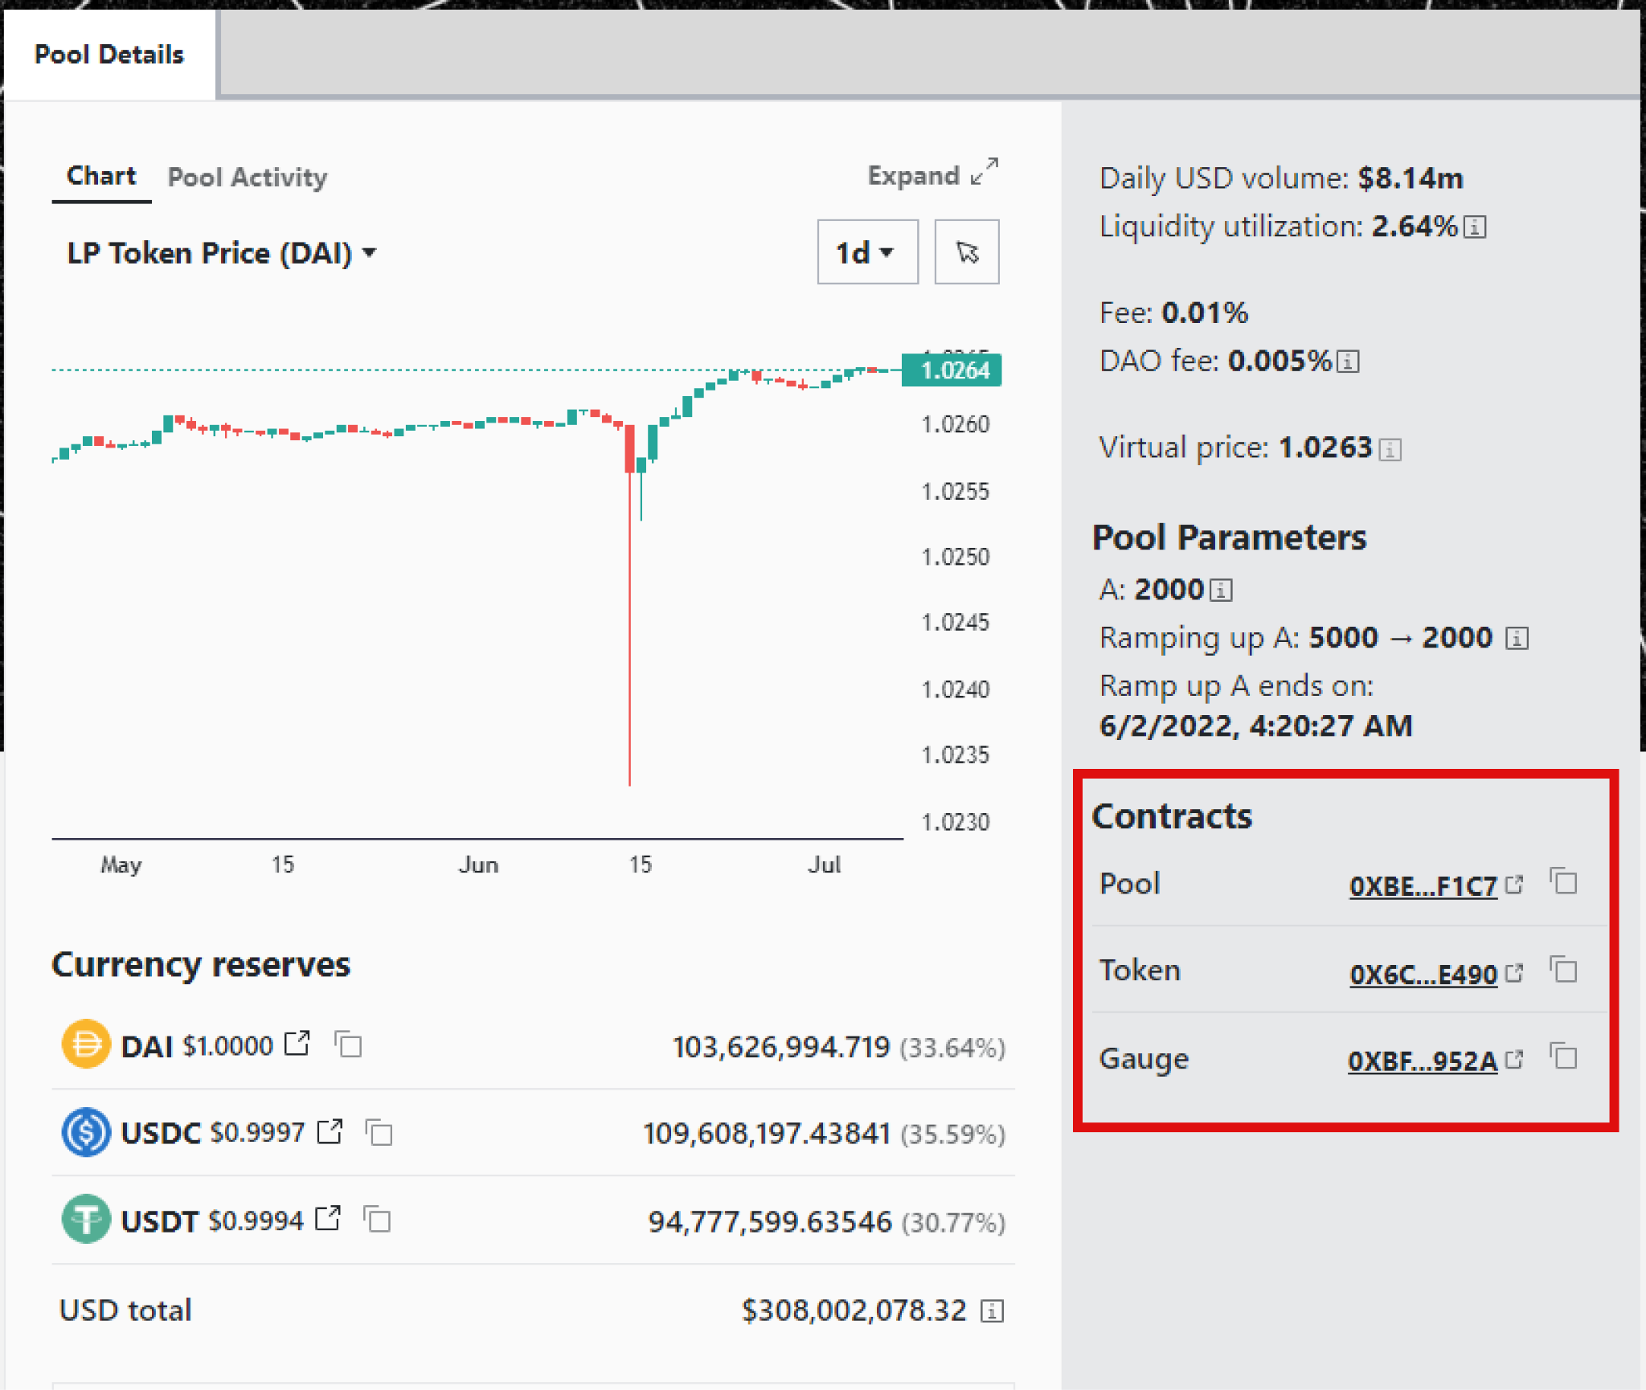
Users can not expand the full address/hash.

Slide 47
CURVE FINANCE UX AUDIT REPORT
PERMANENT NEWBIE MODE
Is educational information woven into normal interaction?
Are there 2 or more levels of educational content: Blockchain basics and Dapp specific lingo?
Is the amount of new things and concepts that the user needs to learn minimized and increased progressively?

Slide 48
Issue (MEDIUM)
Recommendations
Curve fails to effectively weave educational information into normal interactions.
Furthermore, the platform does not provide two or more levels of educational content, covering both blockchain basics and Dapp-specific terminology. This absence of comprehensive educational resources limits users' ability to grasp essential concepts and terminology.
Moreover, the platform does not minimize the amount of new things and concepts that users need to learn, nor does it progressively increase the complexity of educational content, making it challenging for users to grasp unfamiliar concepts.
Integrated Educational Content: Integrate educational information seamlessly into normal interactions, providing users with relevant explanations, tooltips, or guided tutorials that enhance their understanding of the platform's features and processes.
Multi-Level Educational Resources: Develop two or more levels of educational content, including blockchain basics and Dapp-specific lingo, to cater to users with varying levels of familiarity. These resources should cover essential concepts, terminologies, and best practices to empower users to make informed decisions..

Slide 49
CURVE FINANCE UX AUDIT REPORT
GAS PRICE AND TRANSACTION REVERSAL
Is what Gas and Gas price clarified?
Are gas prices ranges suggested and time approximations for the upper and lower bounds clarified?
Are transaction reversals allowed?

Slide 50
Issue (SERIOUS)
Recommendations
Gas Price Ranges and Time Approximations: The platform does not suggest gas price ranges or provide time approximations for the upper and lower bounds. This absence of information makes it challenging for users to estimate transaction costs and plan their interactions accordingly. Clear suggestions and time approximations would help users make informed decisions based on factors like network congestion and gas fees.
Transaction Reversals: The platform does not allow for transaction reversals. This limitation can be problematic if users make unintended or erroneous transactions.
Gas Price Ranges and Time Estimates: Suggest gas price ranges and provide time approximations for the upper and lower bounds. This information will assist users in estimating transaction costs and better planning their interactions based on network conditions and gas fees.
Transaction Reversal Mechanism: Introduce a mechanism for transaction reversals, allowing users to undo unintended or erroneous transactions. This feature will enhance user control, reduce anxiety, and provide a safety net for potential mistakes.

Slide 51
CURVE FINANCE UX AUDIT REPORT
USABILITY SCORE

Slide 52
141/218
MODERATE
Users should be able to use this site or system and complete most important tasks, however the user experience could be significantly improved.
USABILITY SCORE
Ultimately, the usability score is a quantitative or qualitative representation of how usable and effective a product is in meeting user needs and goals. It helps evaluate the success of UX design and identify areas for improvement to enhance the overall user experience.

Slide 53
CURVE FINANCE UX AUDIT REPORT
NEXT STEPS

Slide 54
NEXT STEPS
Suggestions to improve the Curve experience
#1
Incorporate Newbies in Product Roadmap -
Switch from focusing on product development for just veteran users of Curve and involve newbie users in developing a user-centric product.
#2
Implement Findings -
follow up the Implementation of the Research Findings on live platform.

Slide 55
CURVE FINANCE UX AUDIT REPORT
RESOURCES

Slide 56
SOURCES
Explore attached Unabridged UX audit detailed findings on Curve Finance
Expert Review Based On web Usability Guidelines Spreadsheet report
Expert review based on Web3 UX Principles by Beltran Spreadsheet report
Expert review collation and usability score report on Airtable spreadsheet Report

Slide 57



www.generalmagic.io

